Slide 1
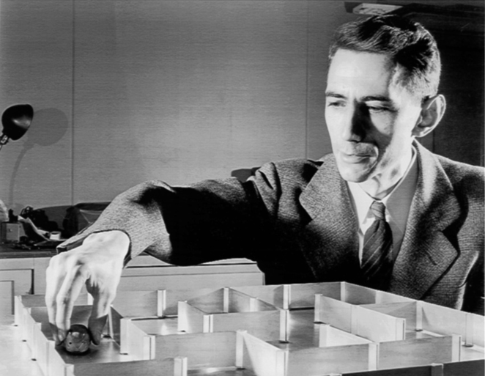
Claude Shannon
(1916 – 2001)
Shannon completed two undergraduate degrees at the University of
Michigan before entering graduate school at MIT. The applications of
Boolean algebra and binary arithmetic described in his MIT masters thesis
revolutionized electrical engineering and formed the basis of digital circuit
Design. Similar applications to genetics lead to his PhD thesis, “An Algebra
for Theoretical Genetics.”
Information theory, cryptography, chess, artificial intelligence, game theory

Slide 2
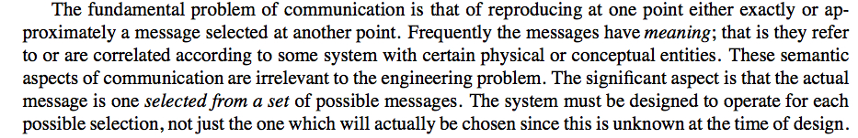
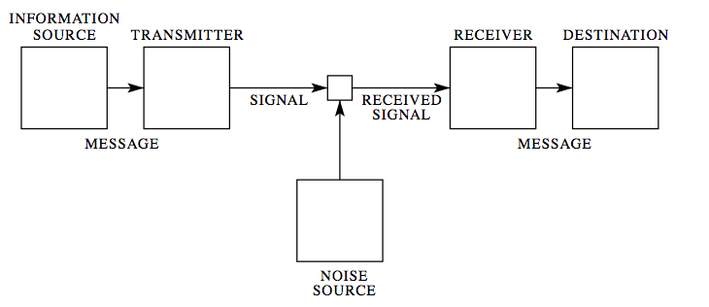
The Mathematical Theory of Communication

Slide 3
Message must be encoded,
then transmitted,
then decoded.
What is the best way to encode and transmit?
(Aside: decoding is an inverse problem!)

Slide 4
The Problem
There are lots of different ways to communicate.
Messages (information sources) take many different forms.
Audio
Languages: English, French, Chinese, Arabic, …
Visual
Sign language, television, …
Other codes?

Slide 5
How we choose to communicate depends critically on the
medium (channel) through which the the message is transmitted.
Speech (phone)
Speech with video (Skype)
Underwater (no speech)
e-mail
Others?
The best way to communicate depends very greatly on the
transmitting medium.

Slide 6
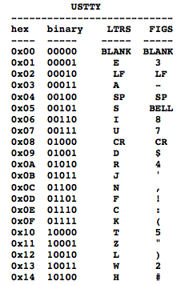
Teletype
Letters have the same duration
Letters mapped to 5 binary digits
[abcde] = [10000]
http://www.youtube.com/watchv=DFMQ1qT_RFM

Slide 7
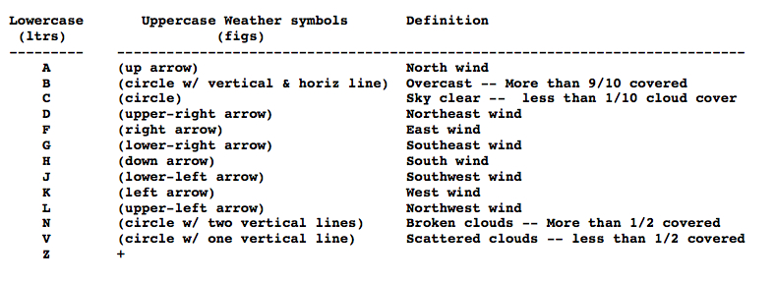
Weather codes

Slide 8
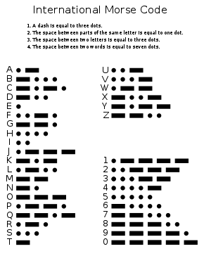
Morse Code
Telegraphy
message: letters
signal: dots, dashes, spaces

Slide 9
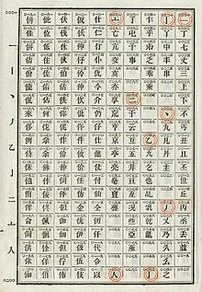
Chinese Telegraph Code

Slide 10



Wabun Code
Morse code used to send Japanese texts
Used to transmit the message "NIITAKA-YAMA NOBORE 12 08”
signaling go-ahead of the Japanese attack on Pearl Harbor
(wikipedia)

Slide 11
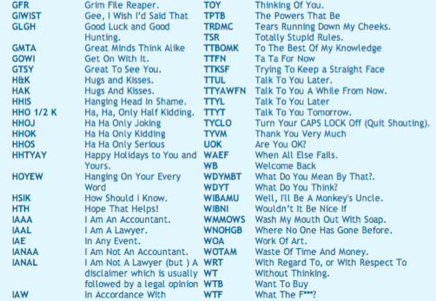
Modern Codes

Slide 12
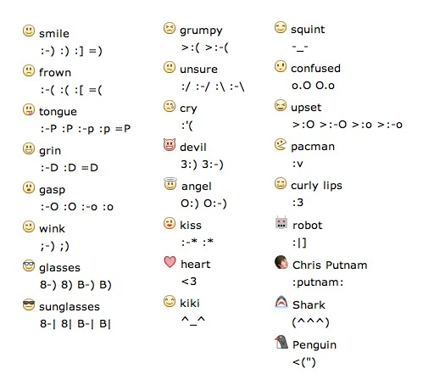
Facebook emoticons

Slide 13
Question
How should one define a “code?” How did Morse do it?
How would you define an “efficient code” of English language?
What does “efficient” mean?
Why might Morse code be more efficient than teletype?
DISCUSS WITH YOUR NEIGHBOR! 5 MINUTE BREAK!

Slide 14
Morse: design code according to letter frequencies
E 11.28%, T 8.46%, A 7.52%, I 7.52%, N 7.52%, O 7.52%,
H 6.02%, R 5.83%, D 4.14%, L 3.76%, U 3.20%, C 2.82%,
M 2.82%, F 2.35%, W 1.88%, Y 1.88%, G 1.60%, P 1.60%,
B 1.50%, V 1.13%, K 0.75%, Q 0.47%, J 0.38%, X 0.38%,
Z 0.19%
E, T, A, I, N, O, S
Presumably “modern” chat symbols are chosen for their
common usage
(interesting senior thesis topic?)

Slide 15
E 11.28%
T 8.46%
A 7.52%
I 7.52%
N 7.52%
O 7.52%
S 7.52%

Slide 16
Question
Now we have a code. How many signals/symbols of the code
can be transmitted per unit time?
Once the code and channel are defined, this is a well-defined math problem!

Slide 17
Morse Code
Dot = line closure for one unit of time and then line open for
one unit of time
Dash = line closure for three units of time and line open for
one unit of time
Letter Space = line open for three units of time
Word Space = line open for six units of time
Additional Rule: cannot have two successive spaces

Slide 18
Possible Signals
Dot = 2 time units
Dash = 4 time units
Dot-space = 5 time units
Dash-space = 7 time units
Dot-word space = 8 time units
Dash-word space = 10 time units

Slide 19
How many signals can be transmitted per unit time?
Let be the number of signals that can form in time
number of signals ending in “dot”
+ number of signals ending in “dash”
+ number of signals ending in “dash-space”
+ number of signals ending in “dot-space”
+ number of signals ending in “dot-word-space”
+ number of signals ending in “dash-word-space”

Slide 20
How many signals can be transmitted per unit time?
number of signals ending in “dot”
+ number of signals ending in “dash”
+ number of signals ending in “dash-space”
+ number of signals ending in “dot-space”
+ number of signals ending in “dot-word-space”
+ number of signals ending in “dash-word-space”

Slide 21
How many signals can be transmitted per unit time?
This is an equation!
Discuss for five minutes with your neighbors!

Slide 22
How many signals can be transmitted per unit time?
How do we solve this?
Let
and substitute into the above equation

Slide 23
How many signals can be transmitted per unit time?
For large t, we have
where x is the largest solution to the this equation

Slide 24

It is tradition to express this rate as the number of bits per second
(bits/sec)
channel capacity
(maximum transmission rate)
bits/time
information rate of this code

Slide 25
An exercise (or project!)
Compute the channel capacity of your favorite encoding scheme!
Note: this is not the whole story. We still need to characterize the
information content of what we’re expressing!

Slide 26
Questions
How much information is expressed by the information source?
How can we mathematically characterize the information content
in this source?
Discuss briefly with your neighbor

Slide 27
Consider Morse Code
The dot-dash codes map to the letters of a language (English).
We know that the distribution of letters in English is not uniform
Example: “E” occurs more frequently than “Q”
“TH” occurs more frequently than “XP”
This means that we know the information source (if the source is
speaking words of English) does not just choose random
sequences of dots and dashes.

Slide 28
Shannon’s Idea
A discrete information source is characterized by the probabilities
for emitting signals from the source

Slide 29
Shannon’s Idea
A discrete information source is characterized by the probabilities
for emitting signals from the source
For example, the probabilities of emitting single letters
EAI JKKOAD DDSPIELVOEIAHE
:-) :-< TTFN :->

Slide 30
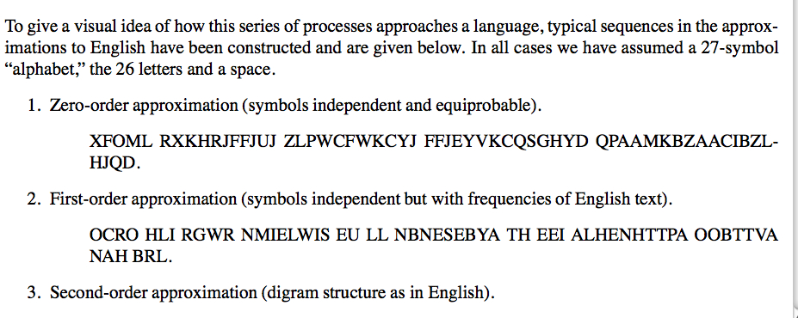
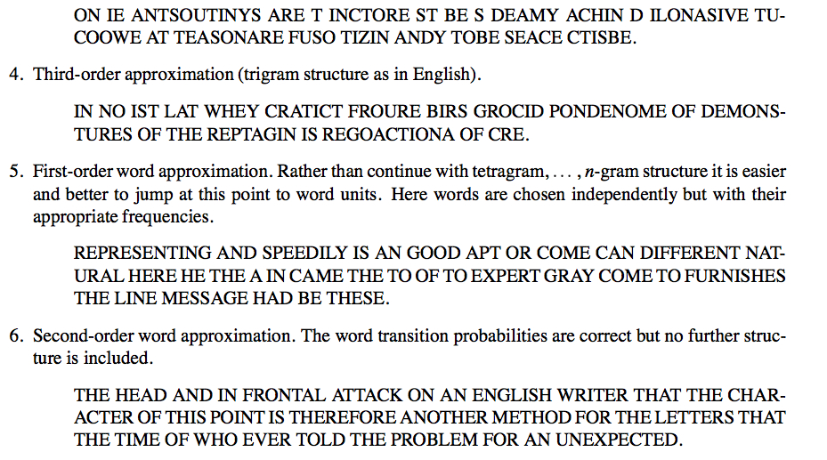

Slide 31
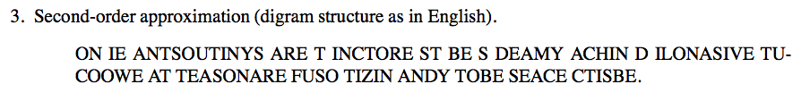


Slide 32
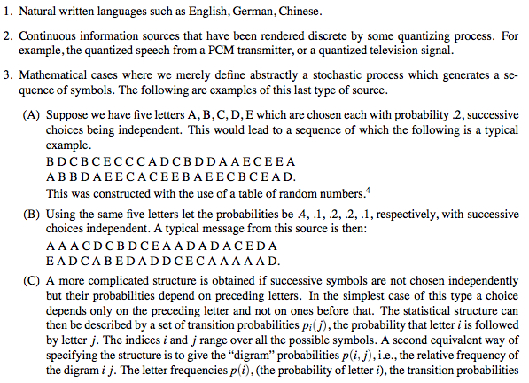
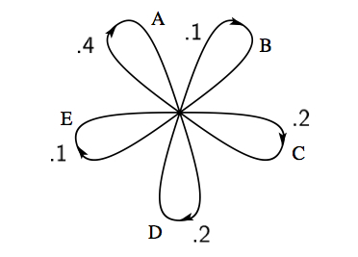

Slide 33
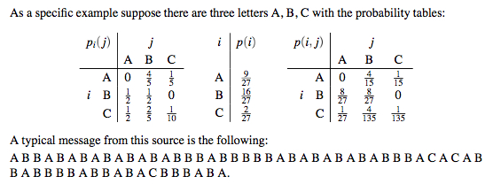

Slide 34
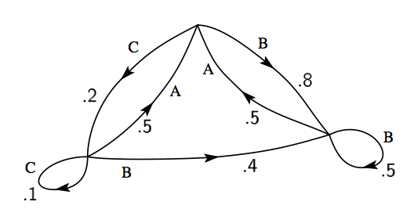

Slide 35
Stochastic processes of this type are called
Markov processes
This is now a mathematical model for an information source.
Now we need to quantify the “information content” of the source.

Slide 36
Measuring Information Content
Suppose we have syllables with probabilities
How much choice do we have in the selection a word?
How uncertain are we of the outcome?
Entropy – measure of disorder or uncertainty in a system
Maximum entropy – exm: toss a fair coin many times
no way to predict outcome of next toss
Minimum entropy – exm: toss a two-tailed coin many times
outcome is certain, next toss is tails

Slide 37
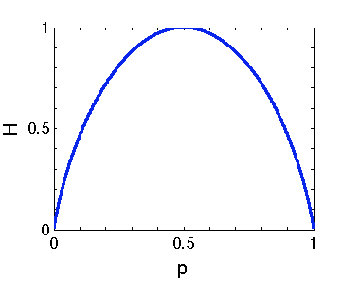
Measuring Information Content
Shannon Entropy
Example (N = 2)
H = 0 only if p = 0 or p = 1.
Makes sense – in these cases we are certain of the outcome
H attains it’s maximum value at p = ½
Makes sense – the most uncertain case

Slide 38
Measuring Information Content
Shannon Entropy
Measures the amount of information transmitted
When you utter a word, how many other choices of words
are you choosing between?

Slide 39
Measuring Information Content
Measuring Information Content
What is the probability of the MOST probable word of N symbols?
Suppose we have a word with N symbols.
On average, there will be
occurrences of the first symbol
occurrences of the second second symbol
…
Hence the probability of the word is

Slide 40
Measuring Information Content
The probability of the word is
In terms of Shannon Entropy
How many “most probable” words are there? About

Slide 41
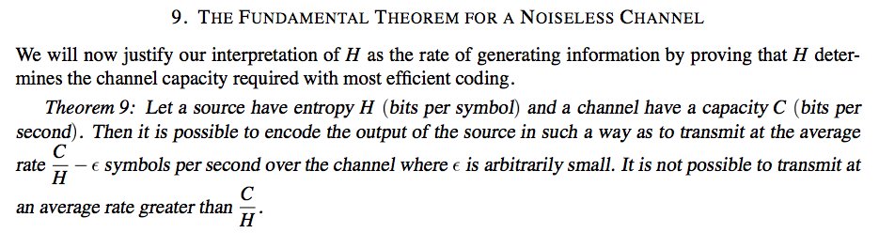
Suppose the information source has entropy H
and channel has capacity C.
Then one can encode the output of the source so that one transmit
at the average rate of C/H symbols per second.
One cannot transmit any faster than C/H!

Slide 42
This week’s lab
Measure information content in a text.
Determine frequency distribution of a words in a text
Check that the distribution obeys Zipf’s law
(frequency of a word is inversely proportional to its rank
in the frequency table)
3. Compute the entropy of the frequency distribution

